Slide 1
ISBN Storage Using Hash Tables
Brandon Brodzinski

Slide 2
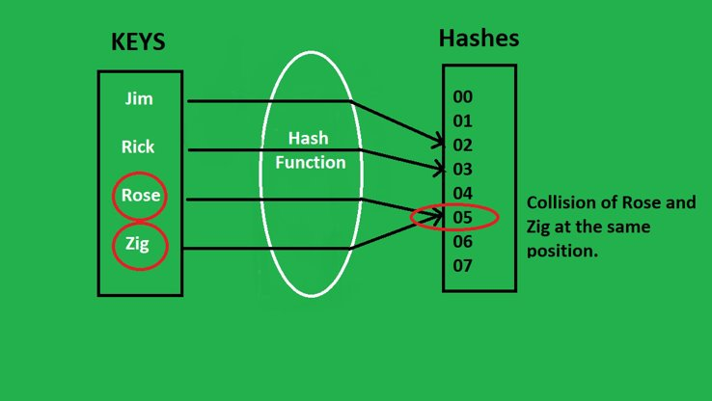
A Quick Recap on Hash Tables
Hash tables are a data structure that store long numbers by using a shorter number generated by passing it through a hash function.
When passed through the function, the long number becomes a shorter number, and that number is used as the index of where it will be stored.
Sometimes, two numbers have the same output from a hash function which causes a collision.
In that instance, quadratic, linear or double hashing can fix the issue.
Diagram of passing keys through a hash function, with a collision occuring

Slide 3
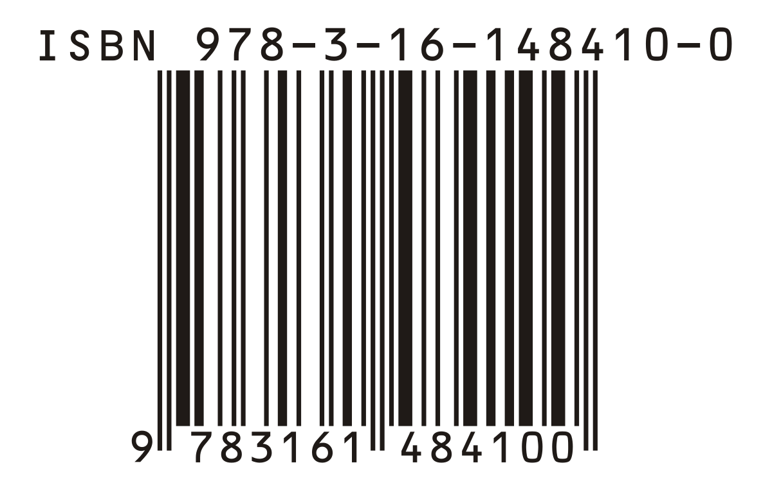
Problem One: ISBN Storage
An ISBN stands for "International Standard Book Number", and they are used to help track and identify books.
Almost every book has one, and each one is typically around 10 to 13 numbers long.
We used hash tables to quickly and efficiently store these numbers, by passing the ISBN through a hash function and using that number for our index.
Example of an ISBN barcode, complete with actual number above

Slide 4
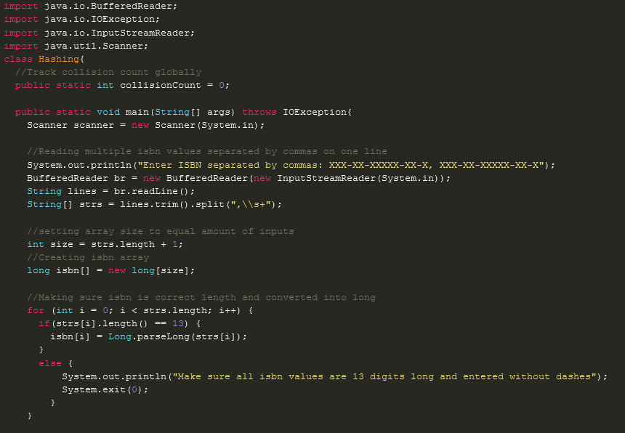
Implementation of Main
Declare collision count
Getting input all on one line so we can have mutliple isbns entered at once
Buffered Reader is a class which simplifies reading text from a character input stream
It buffers the characters in order to enable efficient reading of text data
Creating array for isbns as well as creating the size
Making sure isbn is correct length then converting string into a long

Slide 5
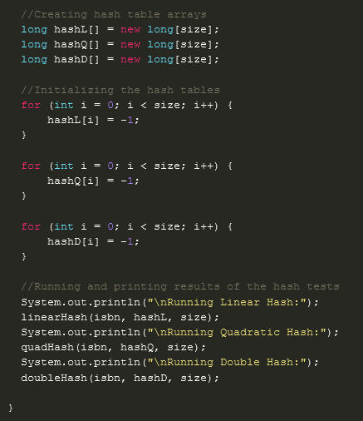
Implementation of Main
Creating hash tables for each kind of hashing method
Initializing all the hash tables
Pass isbn array, hash table arrays, size to each function respectively
Effective way to compare the results of each method to get a sense of how many collisions happen and how fast each function runs

Slide 6
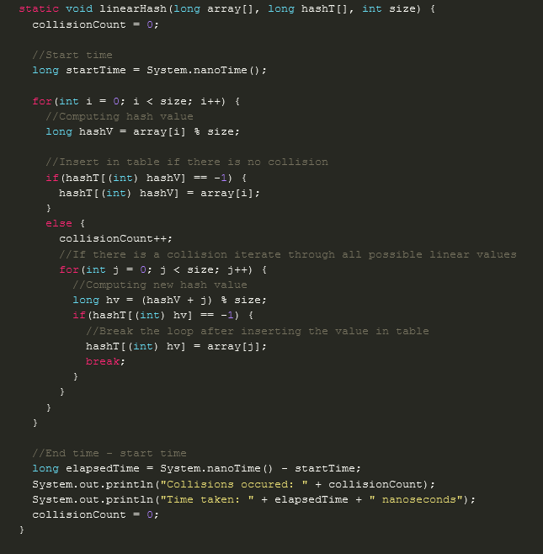
Implementation of Linear Hashing
Values are passed through the function "array[i] % size" to get the hash value.
That hash value is used as the index of the value and is inserted into HashT, unless there is a collision.
In the case of a collision, we iterate through all possible values by taking the first generated hash value, adding j to it, then get the remainder of that divided by size ((hashV + j) % size)
This continues until a free index is found.

Slide 7
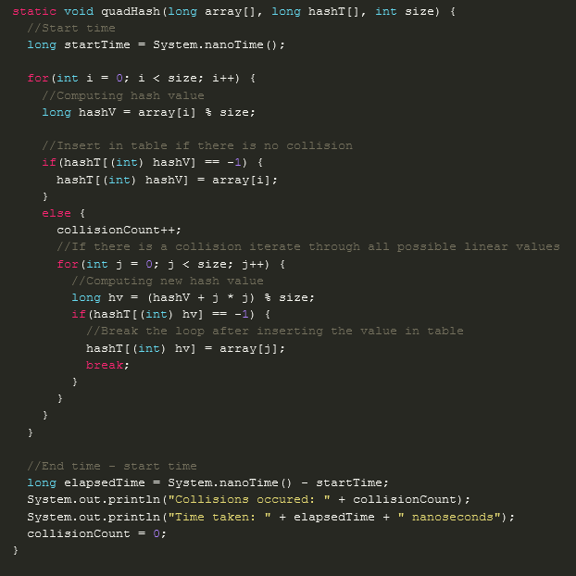
Implementation of Quadratic Hashing
Like Linear hashing, we pass values through the function "array[i] % size" to get the hash value.
We follow the same logic until we arrive at what to do if we run into a collision.
In the instance of a collision, we generate a new hash value by adding j to the original hash value, multiplying by j, and getting the remainder of that divided by size ((hashV + j * j) % size)
Once a free index is found we insert and break the loop.

Slide 8
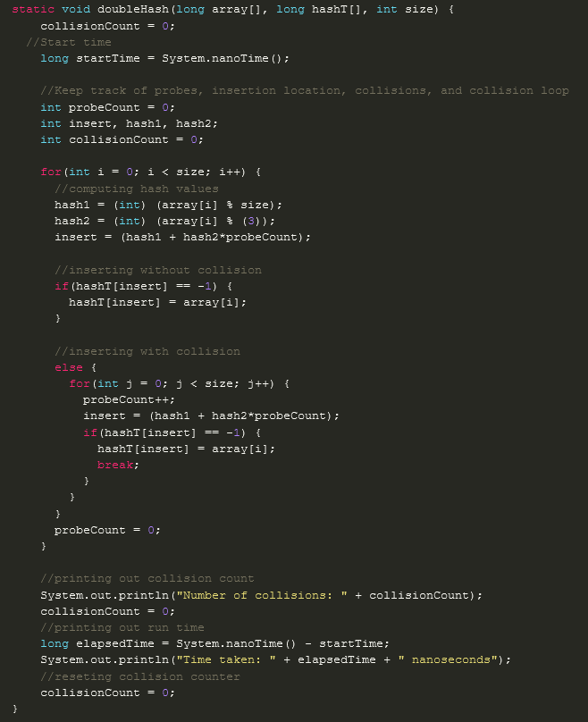
Implementation of Double Hashing
Instead of starting by only hashing once, we hash using two functions, hence the name double hashing. We add those two values together and multiply them by our probeCount (hash1 + hash2*probeCount) to create our insertion; where we will try to insert into the array.
If a collision occurs, we start a loop that increments probeCount, and we run our function again, checking for collisions.
If no collision occurs, we insert our value and break the loop.

Slide 9
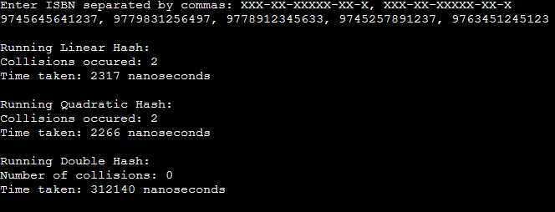
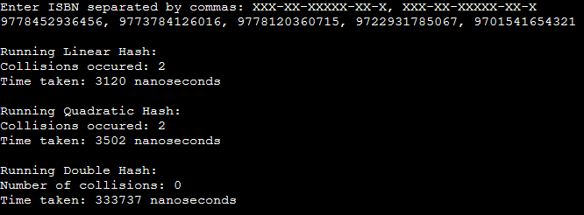
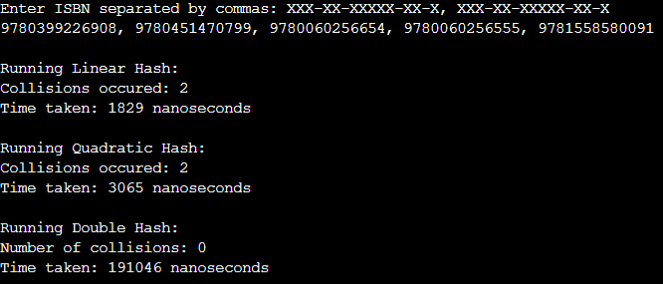
Output
2nd
1st
3rd
Using 3 different inputs of ISBNs, we see that double hash consistently runs the slowest, while linear hash wins two out of three times compared to quadratic hash.
1st
2nd
3rd
1st
2nd
3rd

Slide 10
Issues During Development
There were several cases during testing where the linear and double hash functions would throw outOfBoundsExceptions. This was solved by correcting the size variable, by adding one, that was passed to both functions.

